Slide 1

Cab Price Prediction
Predicting the cab fares and their dependence on weather and other variables

Slide 2
The Problem?
Client wants to switch to a third-party transportation vendor
Our task is to build a model that can predict the cost for each of their employees
The client can then utilize the model and prepare a budget for their next quarter

Slide 3
The Dataset
Weather and Rides data
Boston City
Data Collection Period ~ 1 week
Target column is Price
Regression Problem

Slide 4
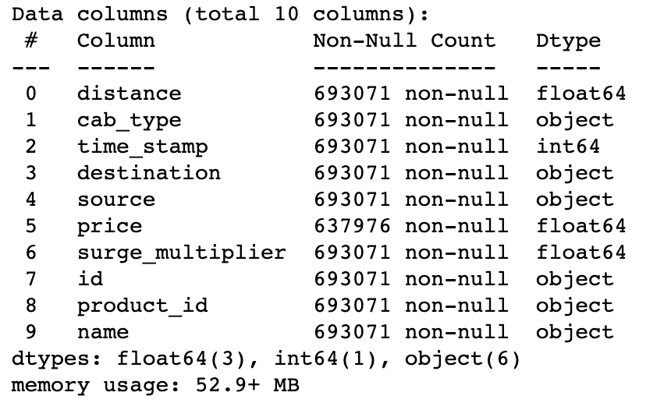
Rides Data Variables

Slide 5
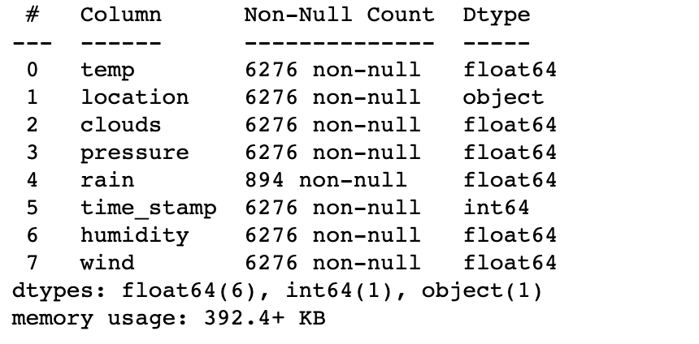
Weather Data Variables

Slide 6
Data Cleaning and Preprocessing
Null value rows are eliminated in the Rides Data Frame
Null values are replaced with 0 in the Weather Data Frame
Label encoding is utilized to encode the object variables and convert them to numerical values
Timestamp is converted to add two additional features: hour of day and day of week

Slide 7
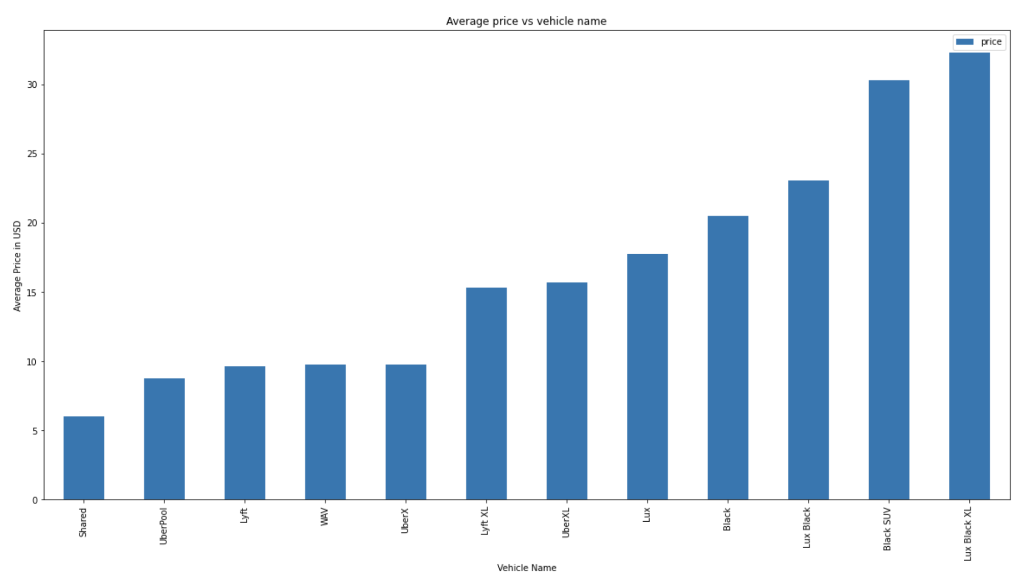
Visualizations

Slide 8
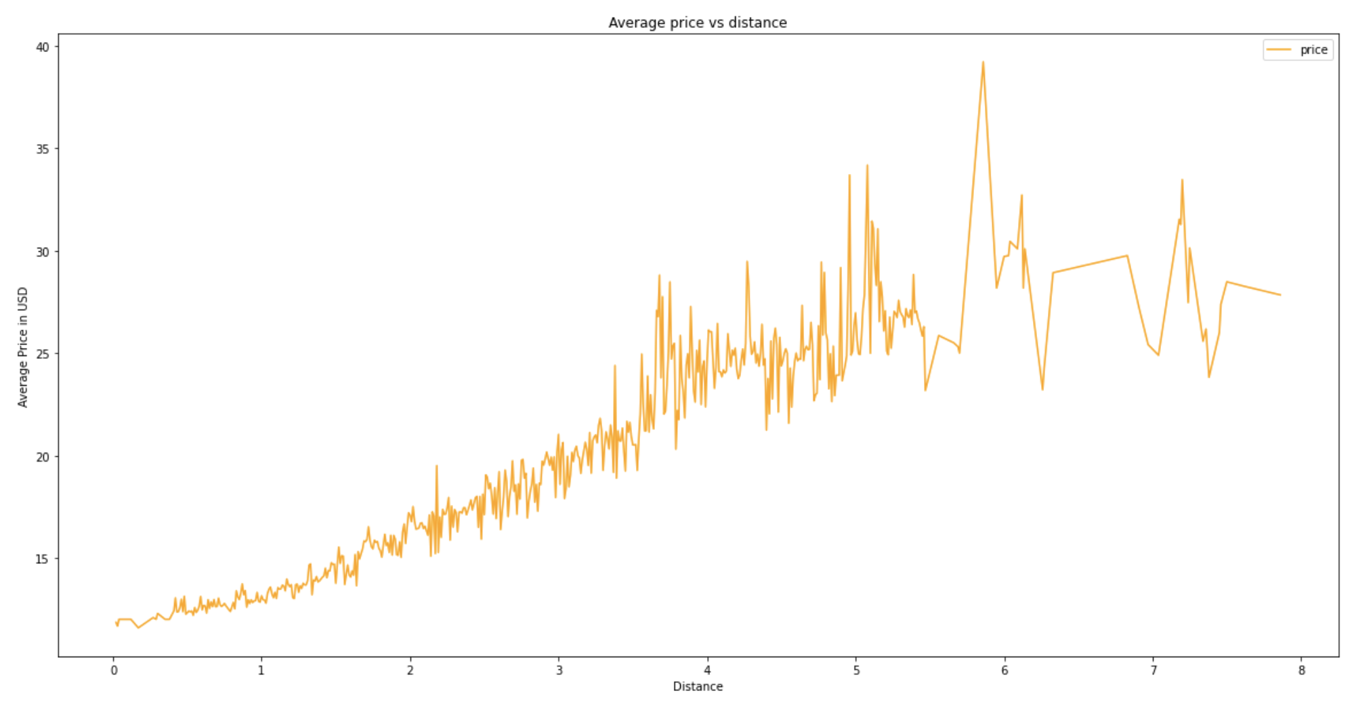
Average Price vs Distance

Slide 9
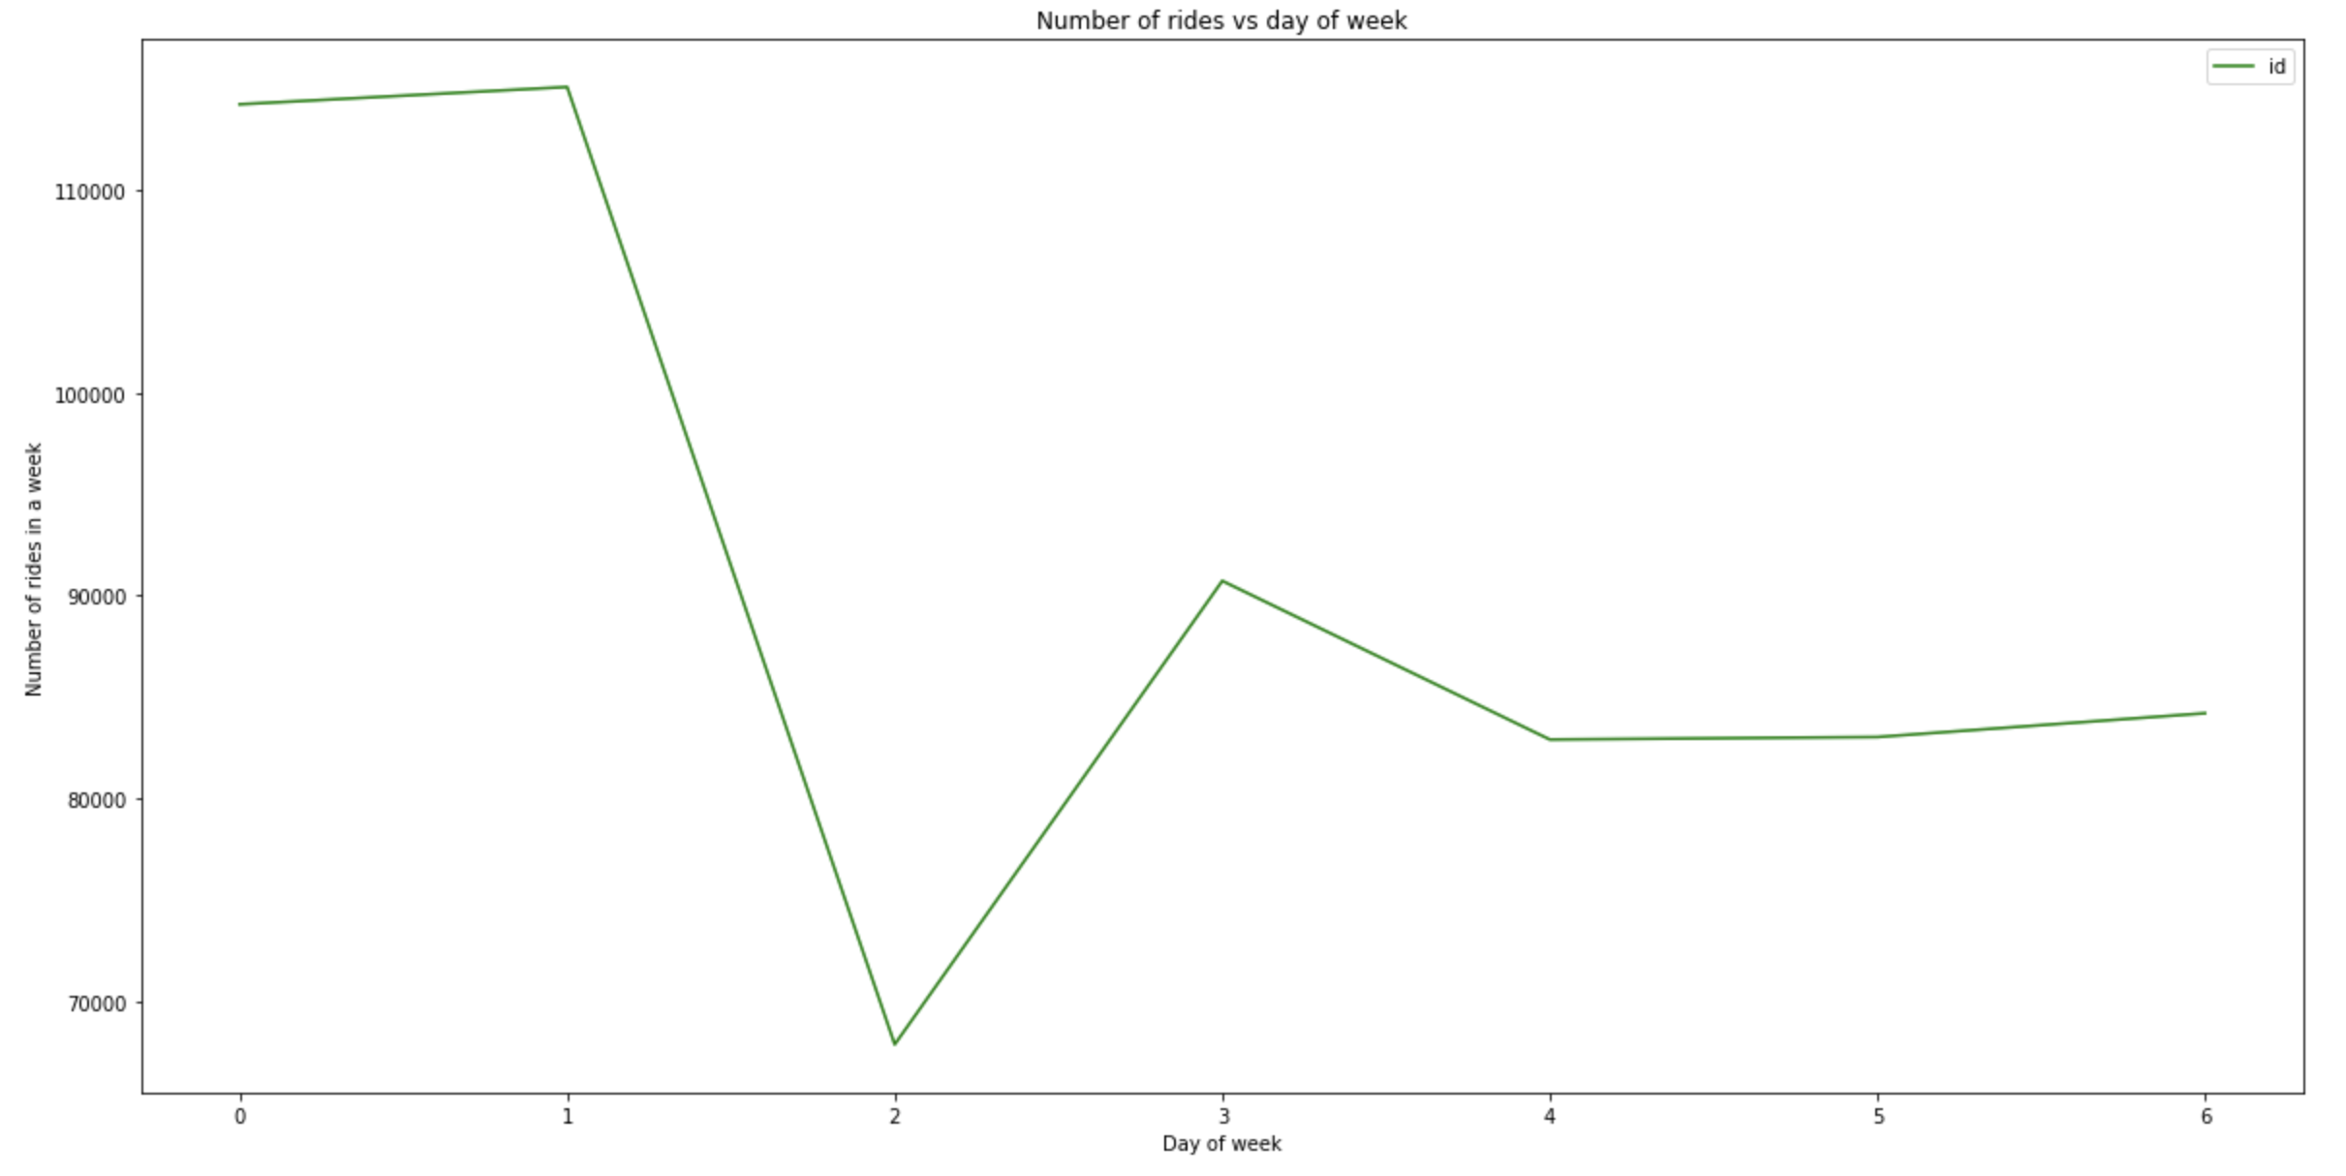
Total Number of Rides in a Week

Slide 10
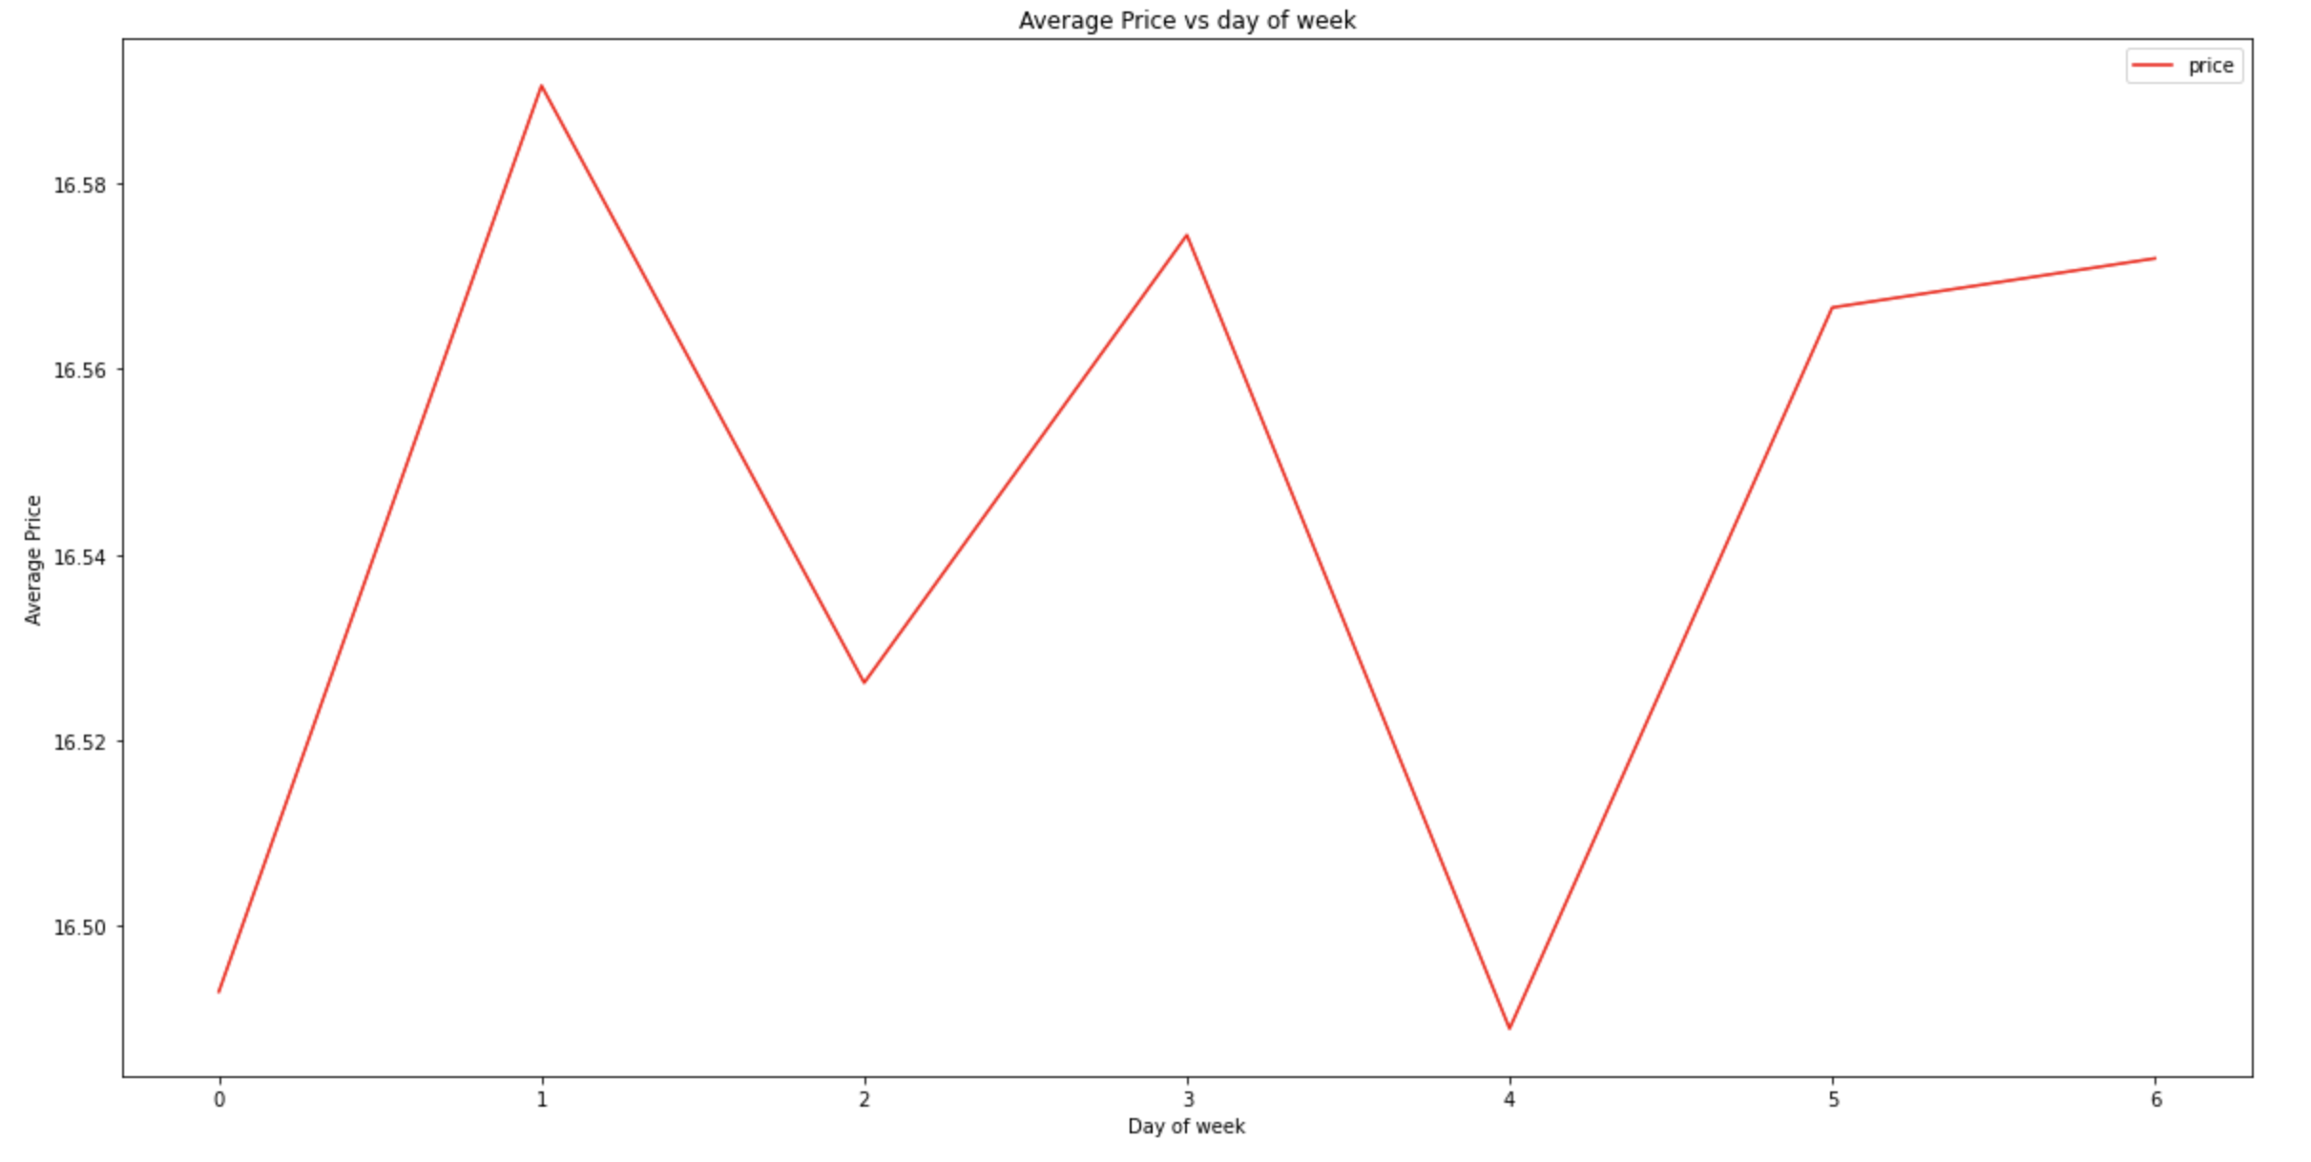
Average Price vs Day of Week

Slide 11
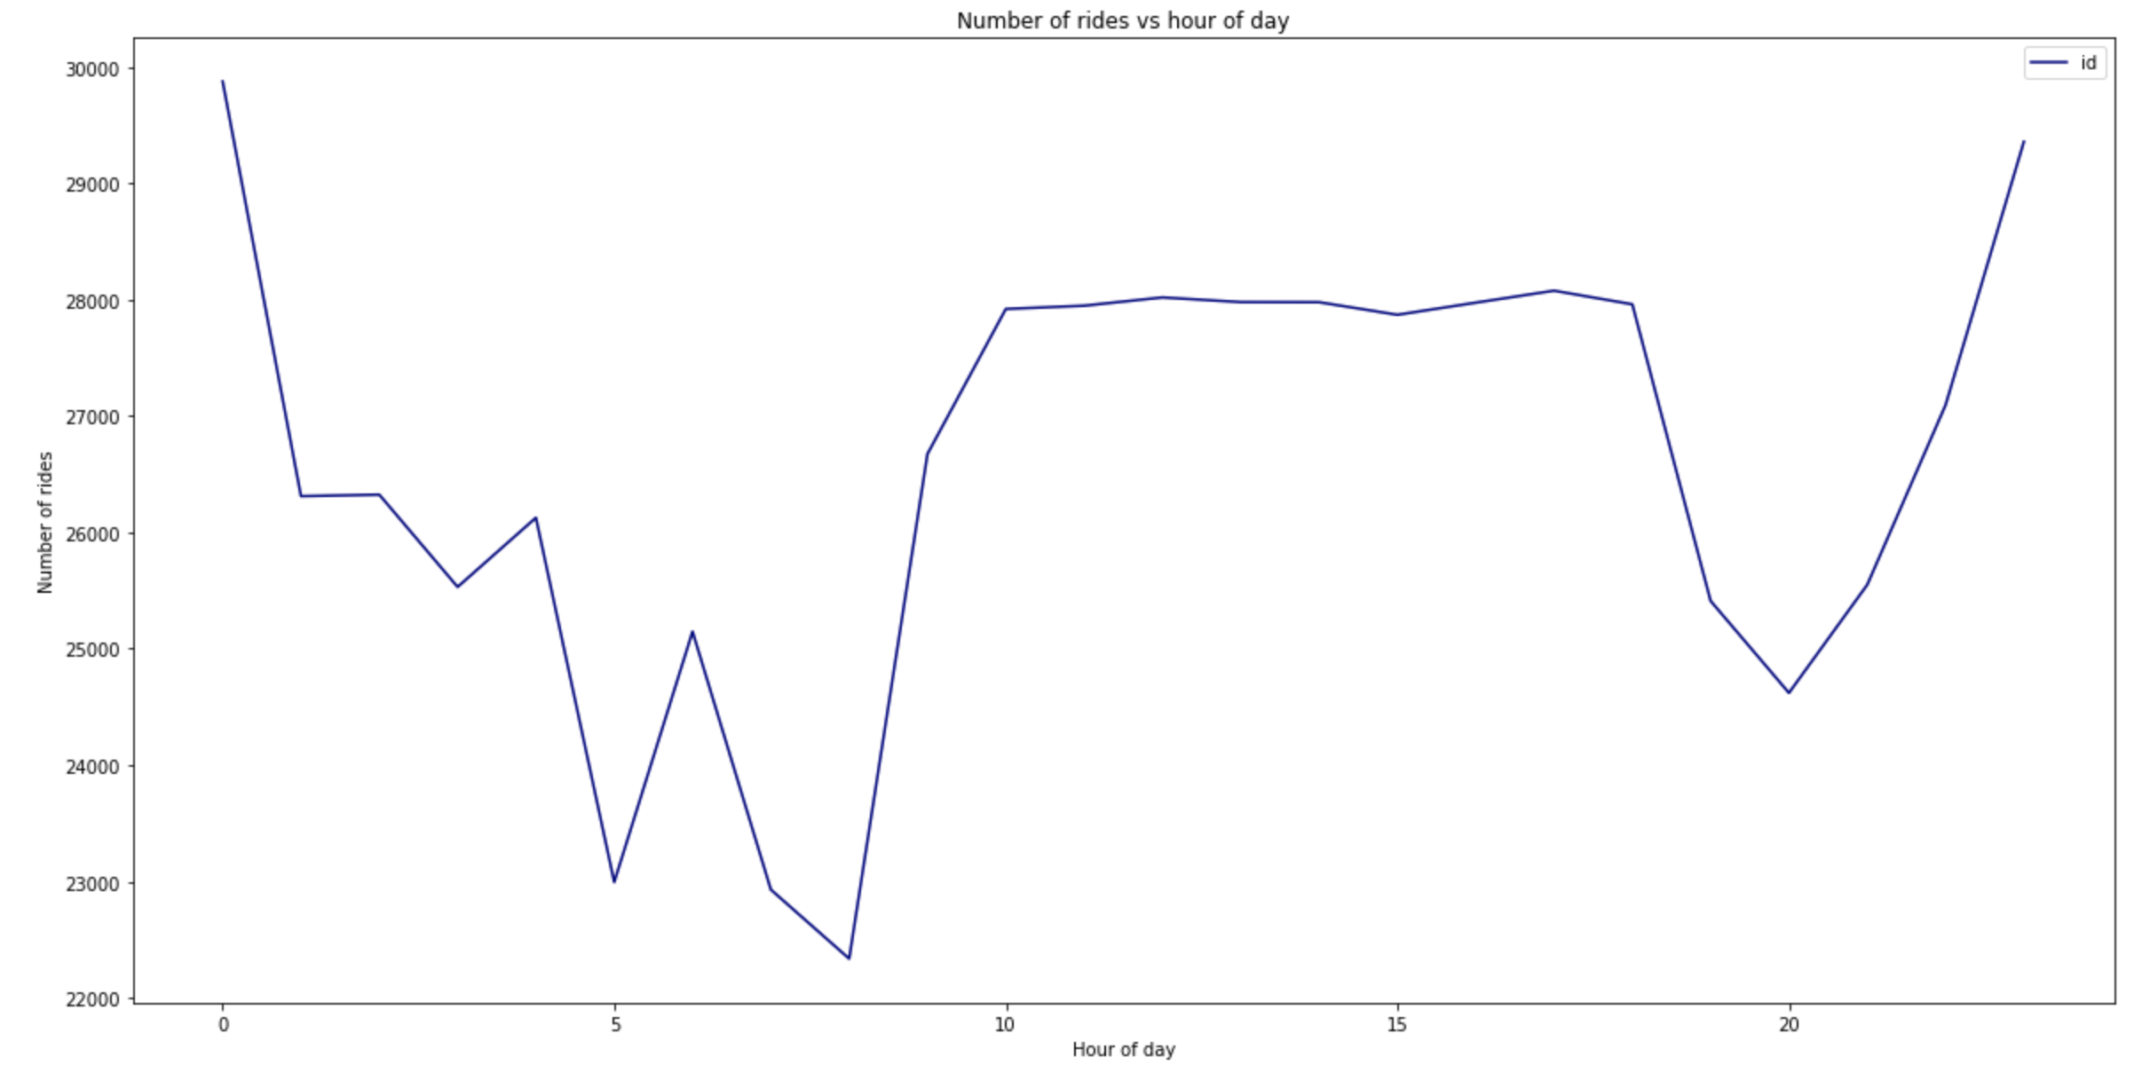
Ride Count vs Hour of Day

Slide 12
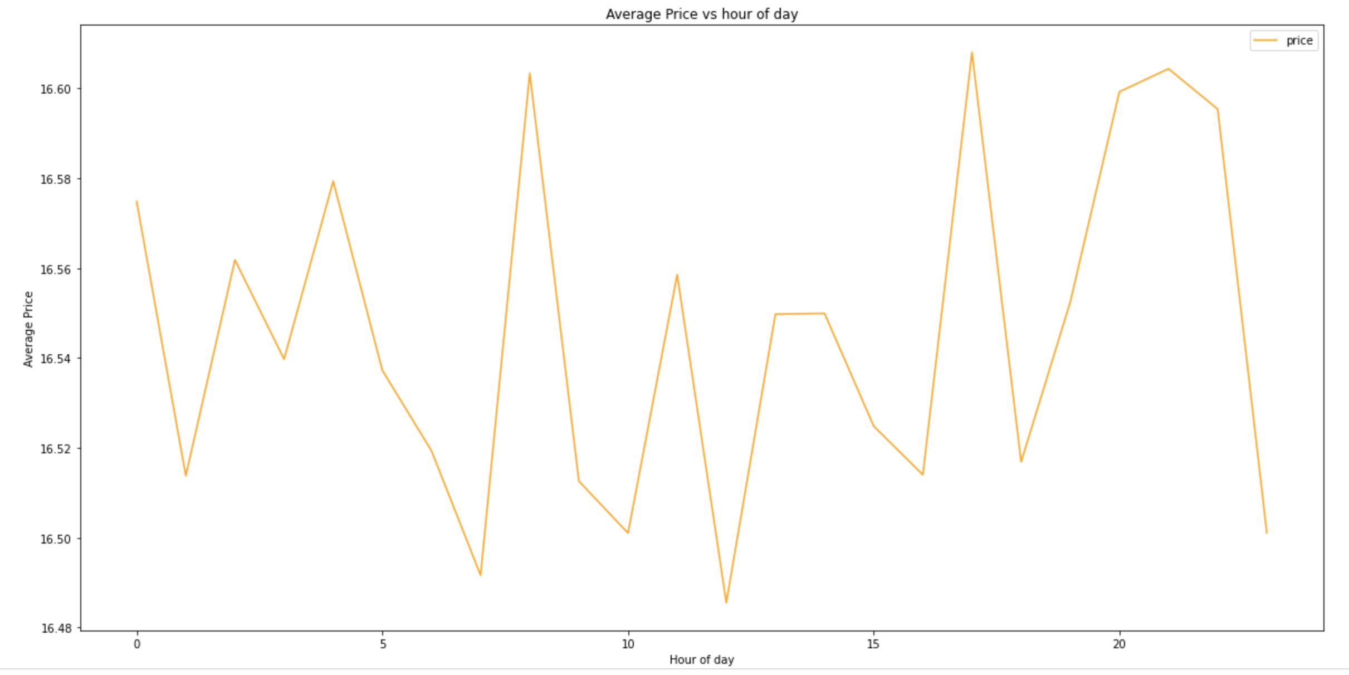
Average Price vs Hour of Day

Slide 13
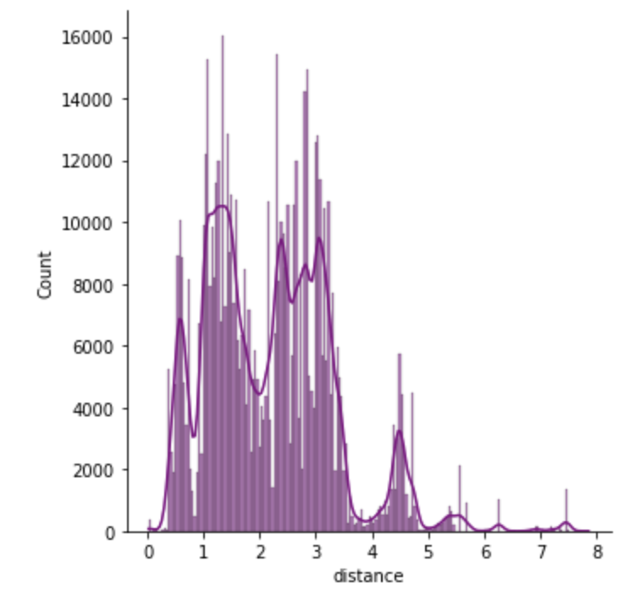
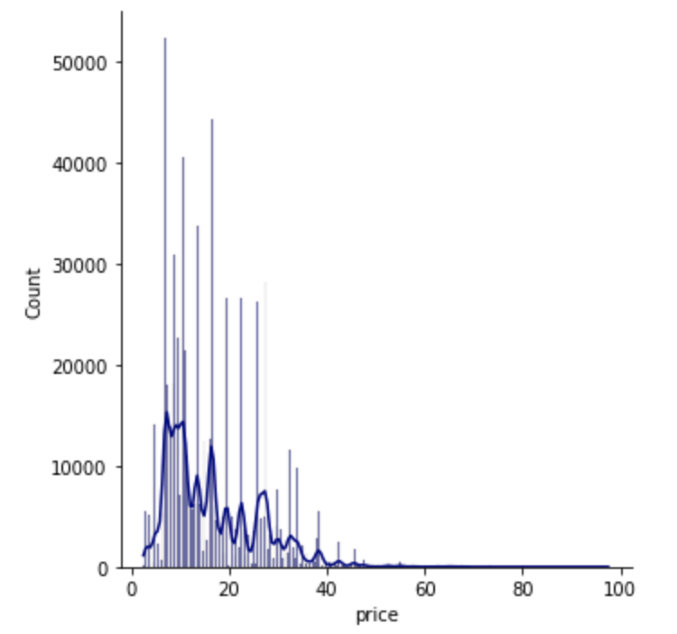
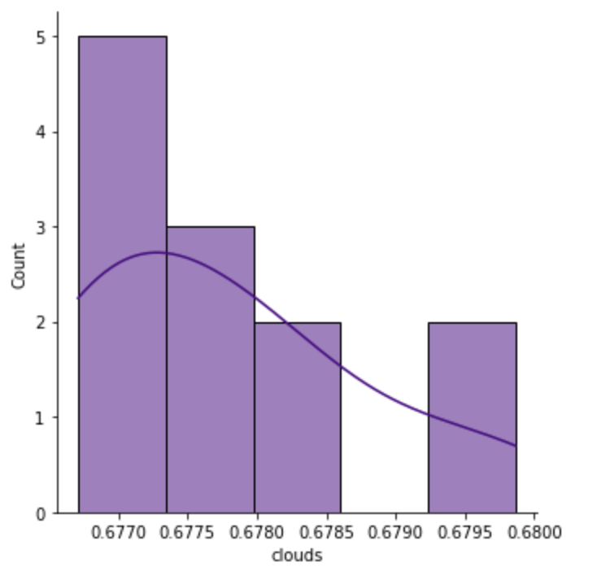
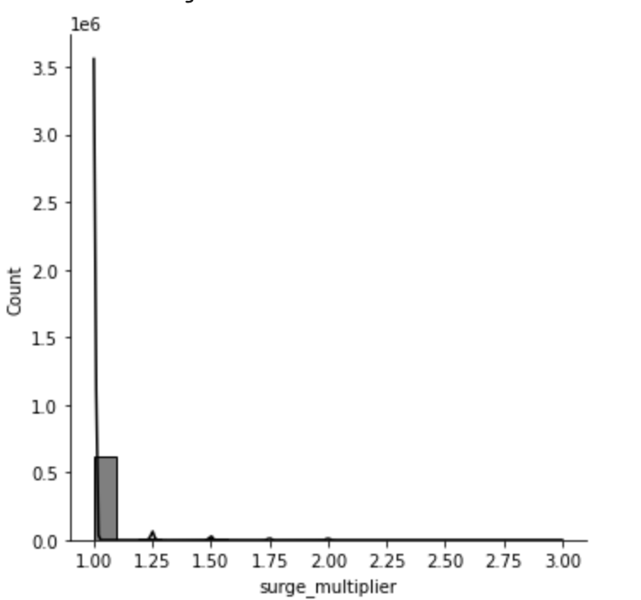
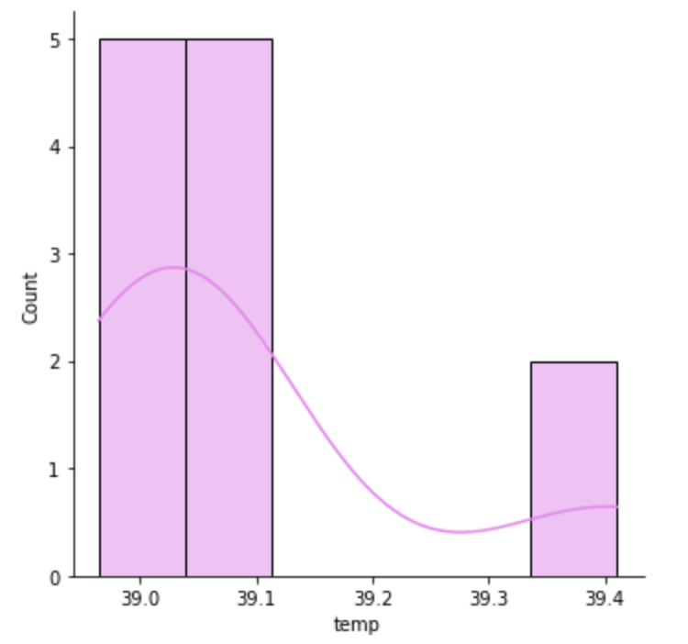
Frequency Distributions

Slide 14
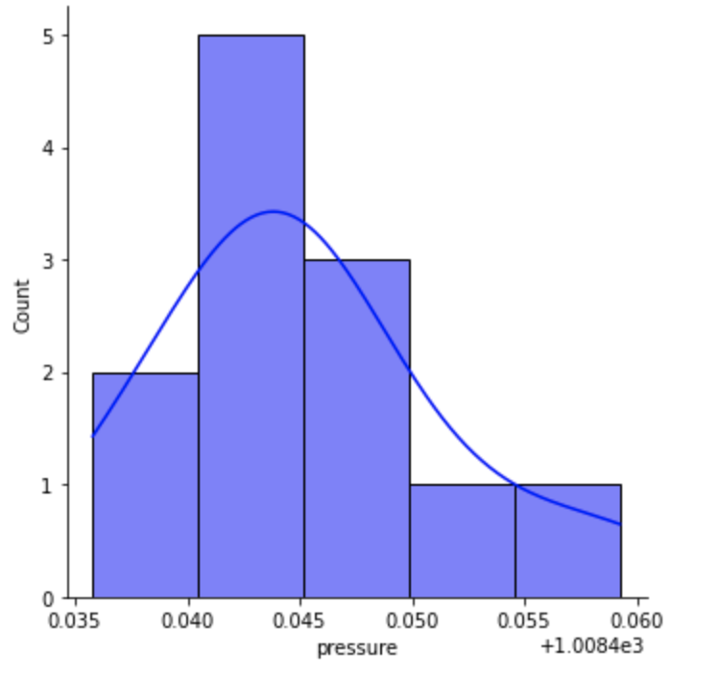
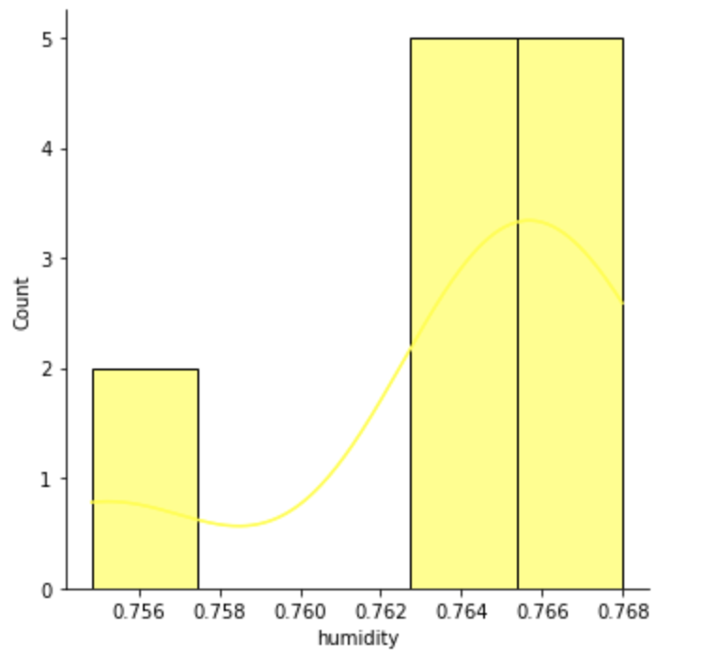
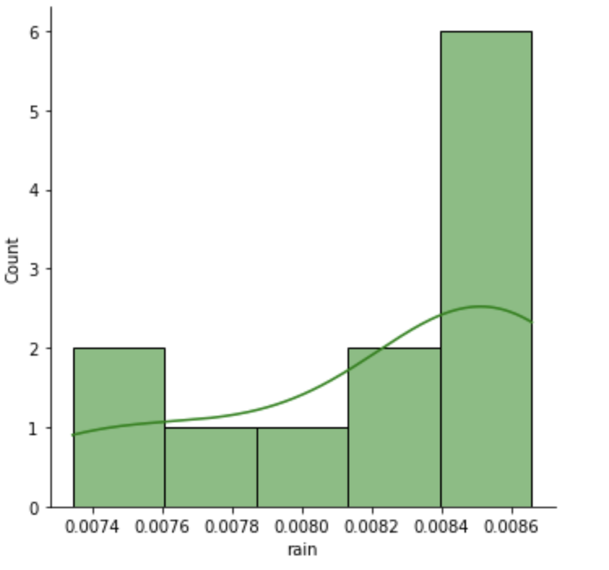
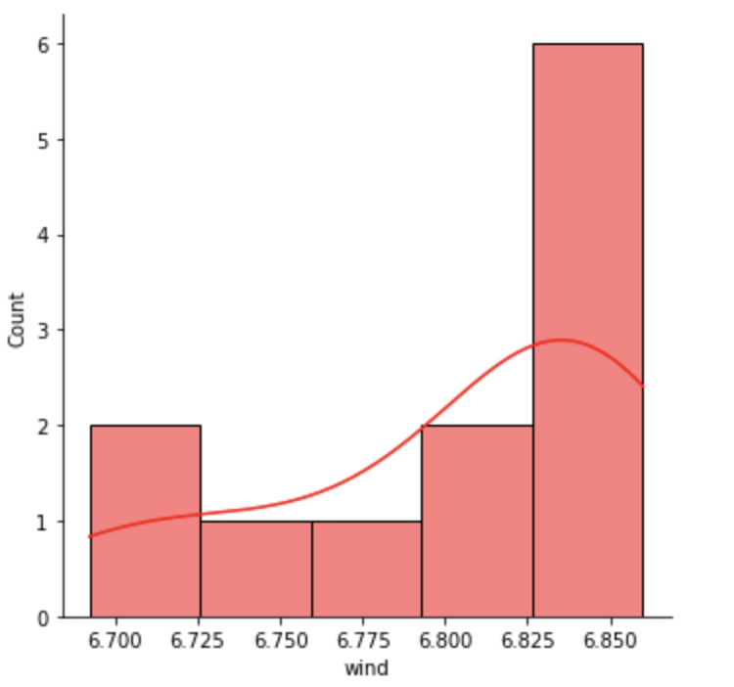
Frequency Distributions

Slide 15
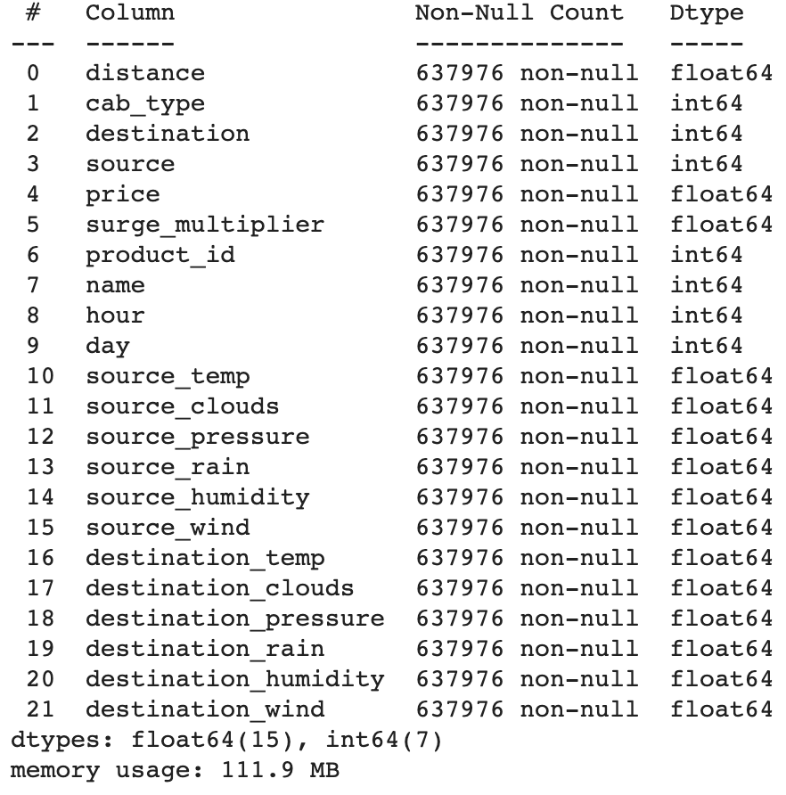
Combined Data - ABT

Slide 16
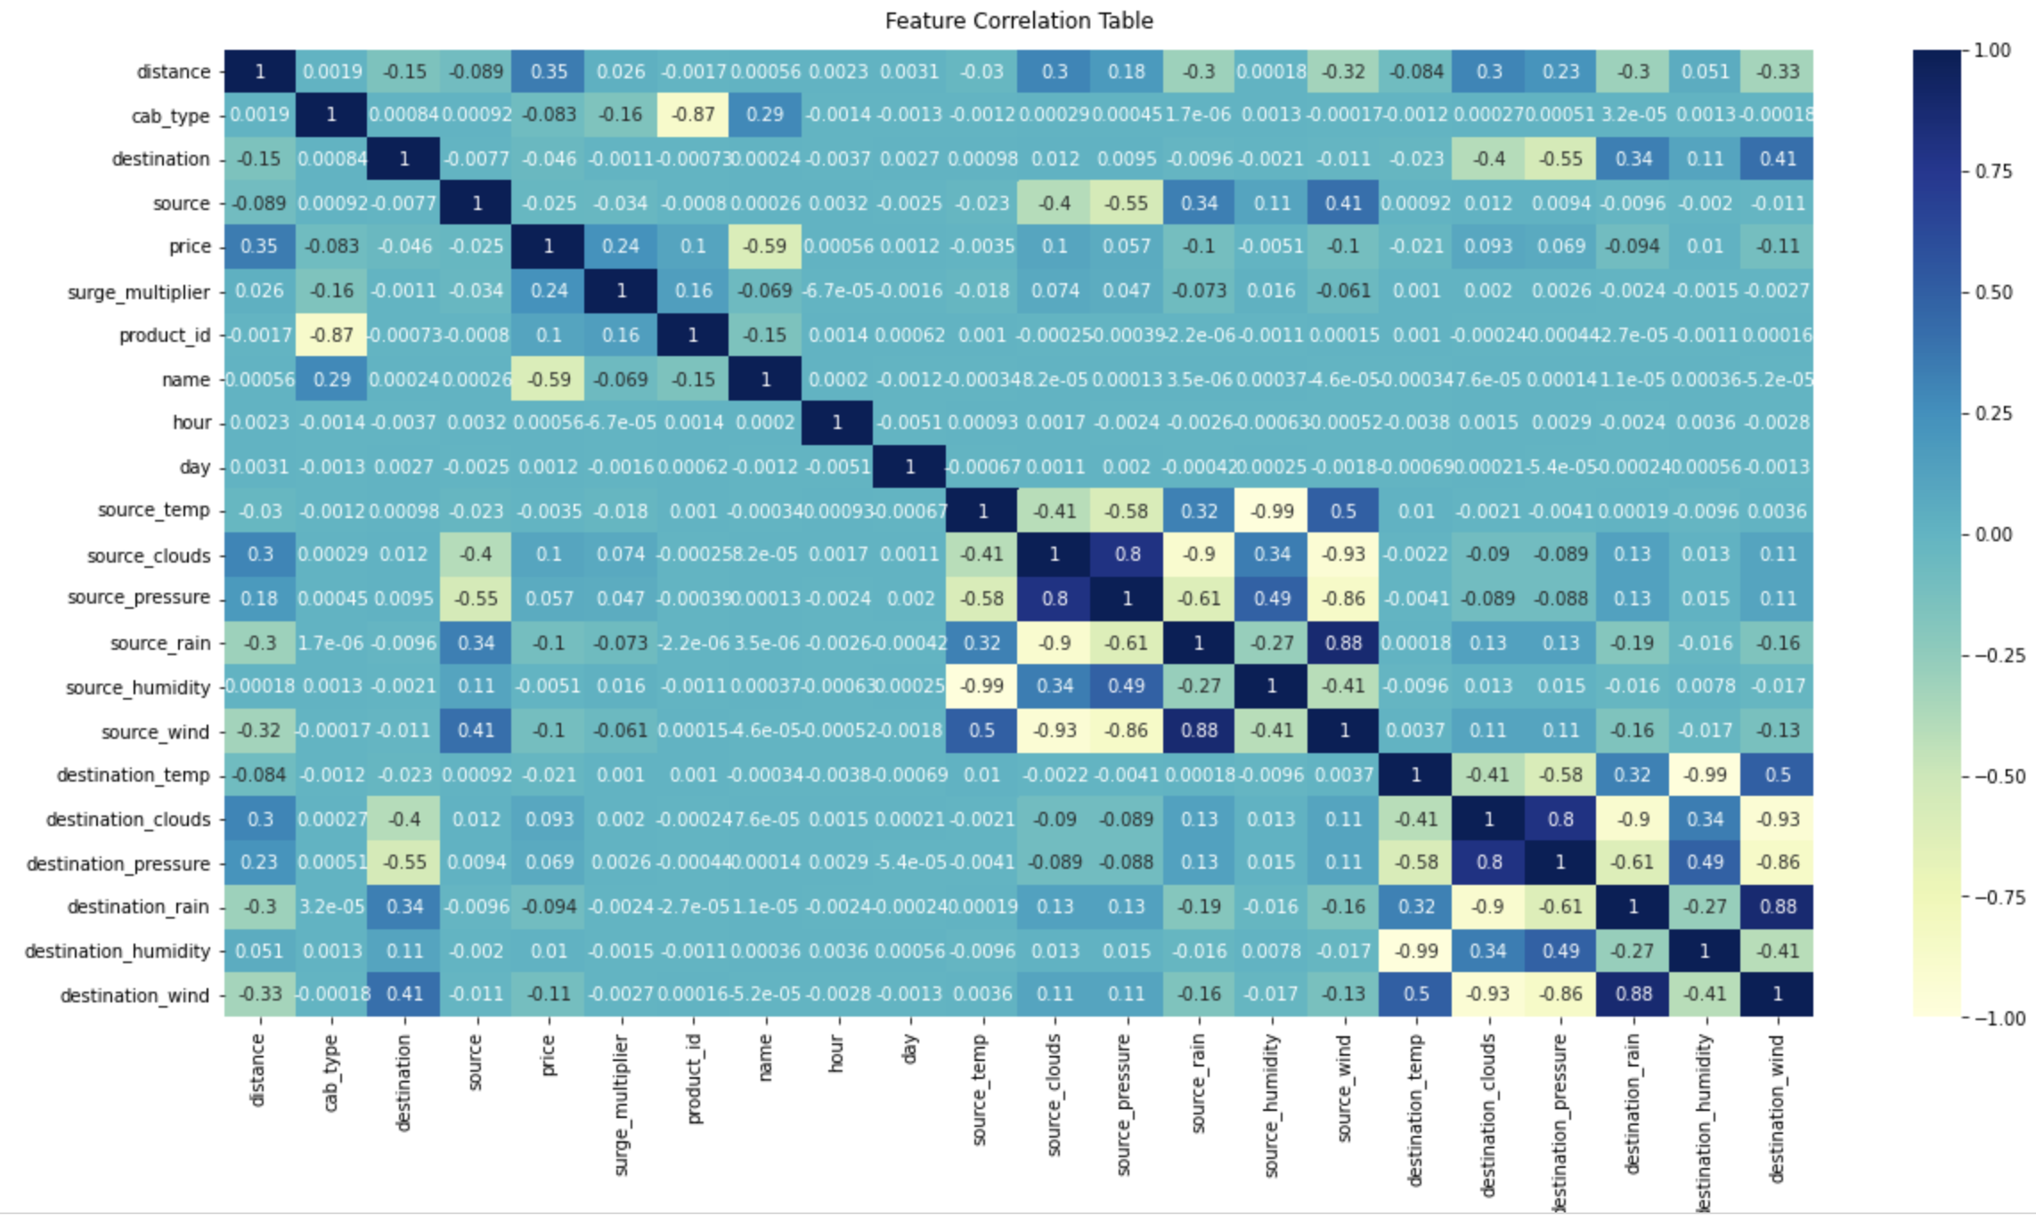
Correlation Matrix

Slide 17
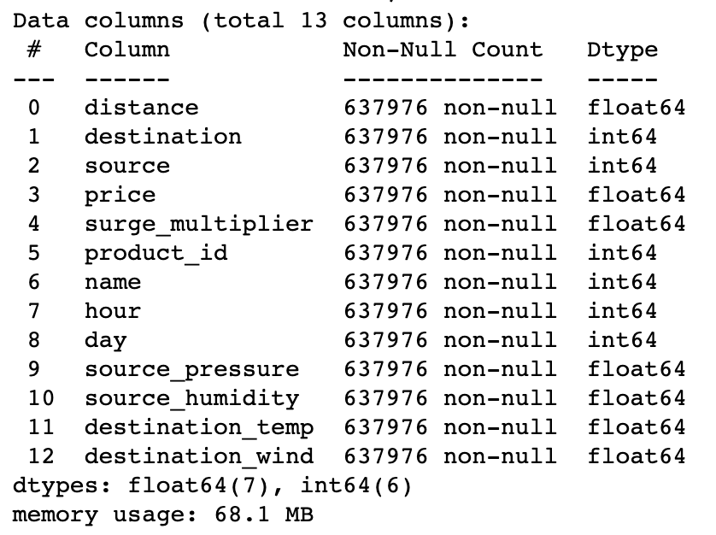
Combined Data – ABT Improved

Slide 18
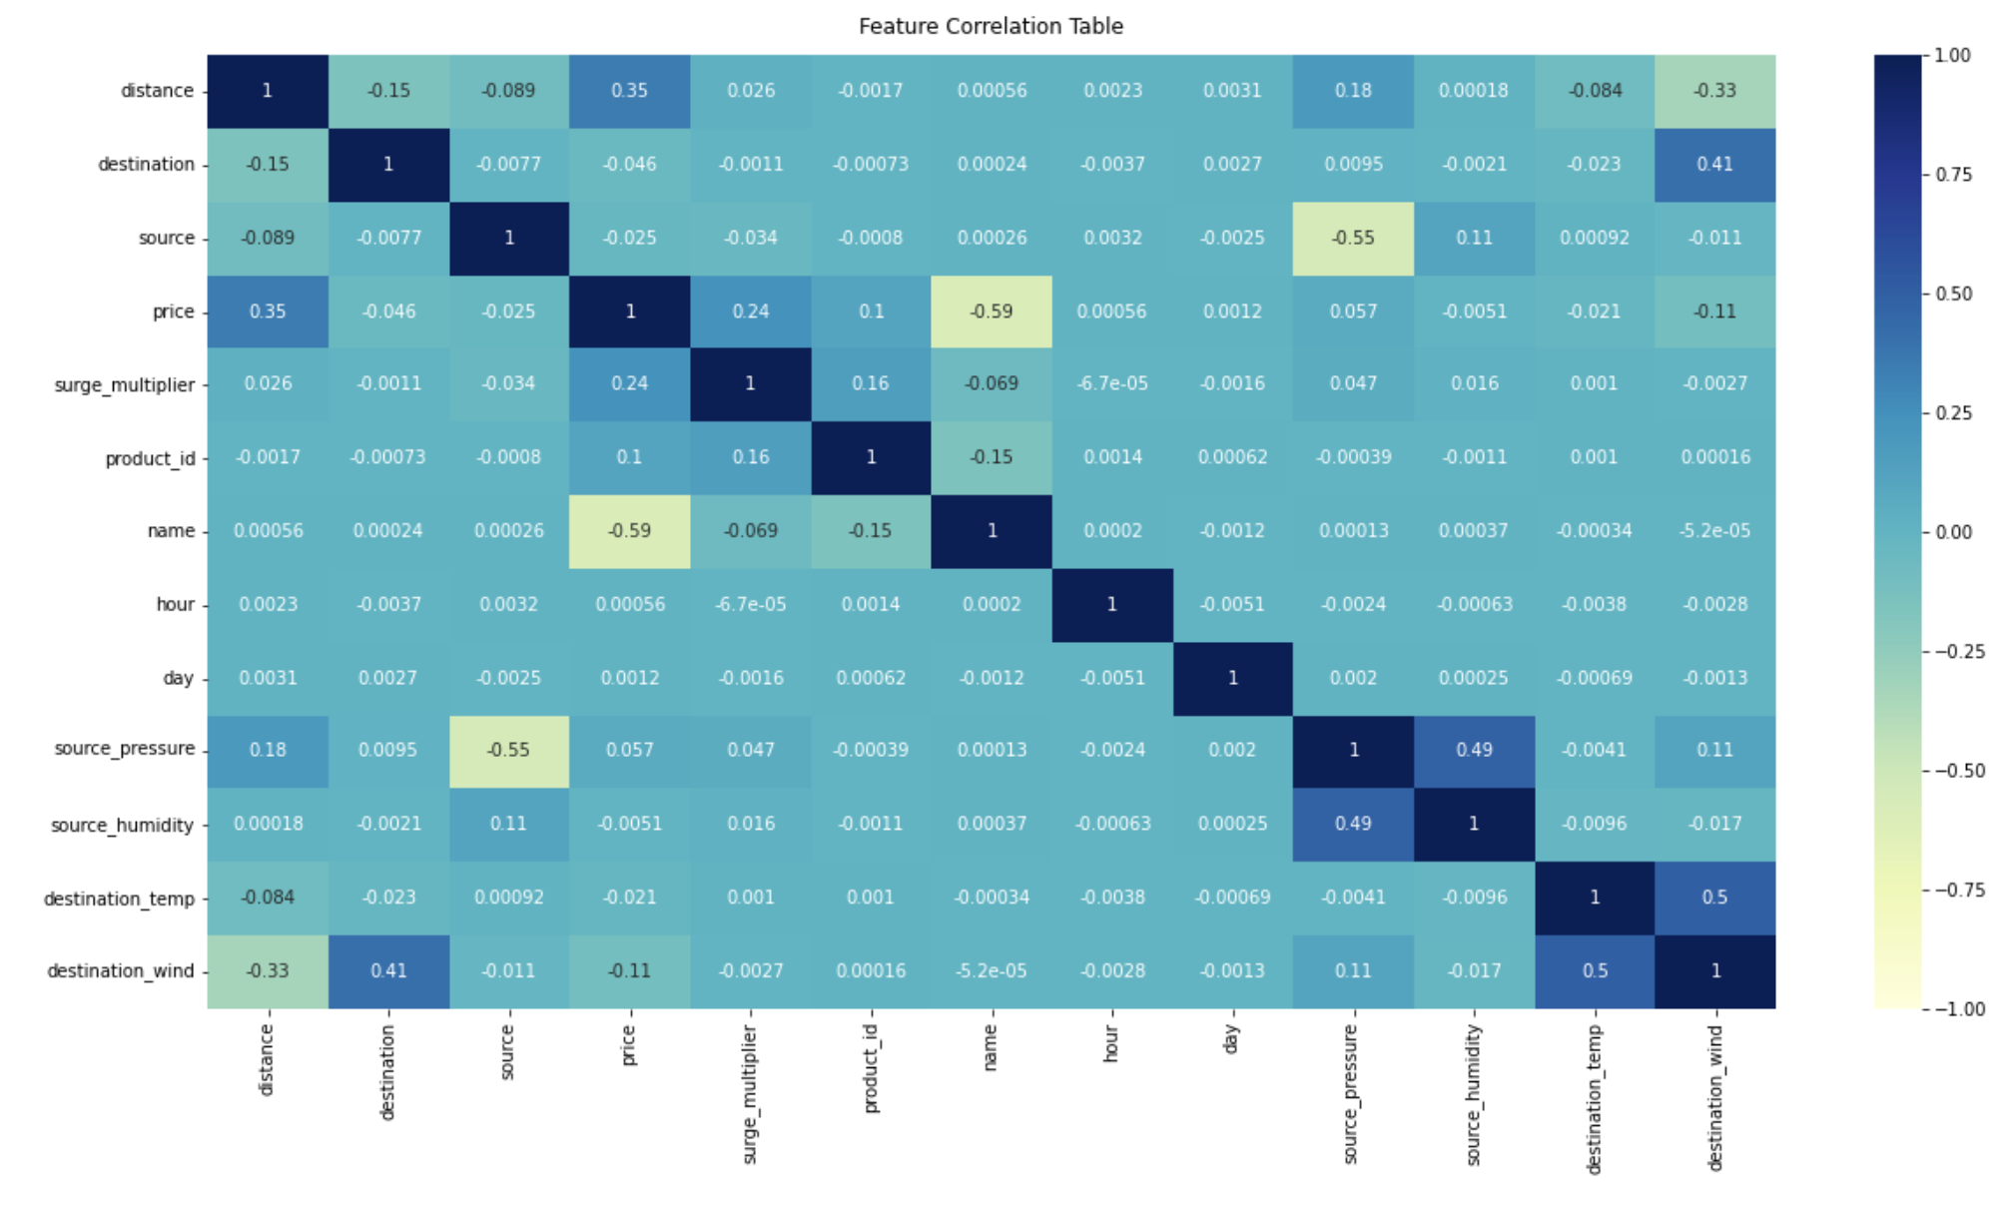
Correlation Matrix Improved

Slide 19
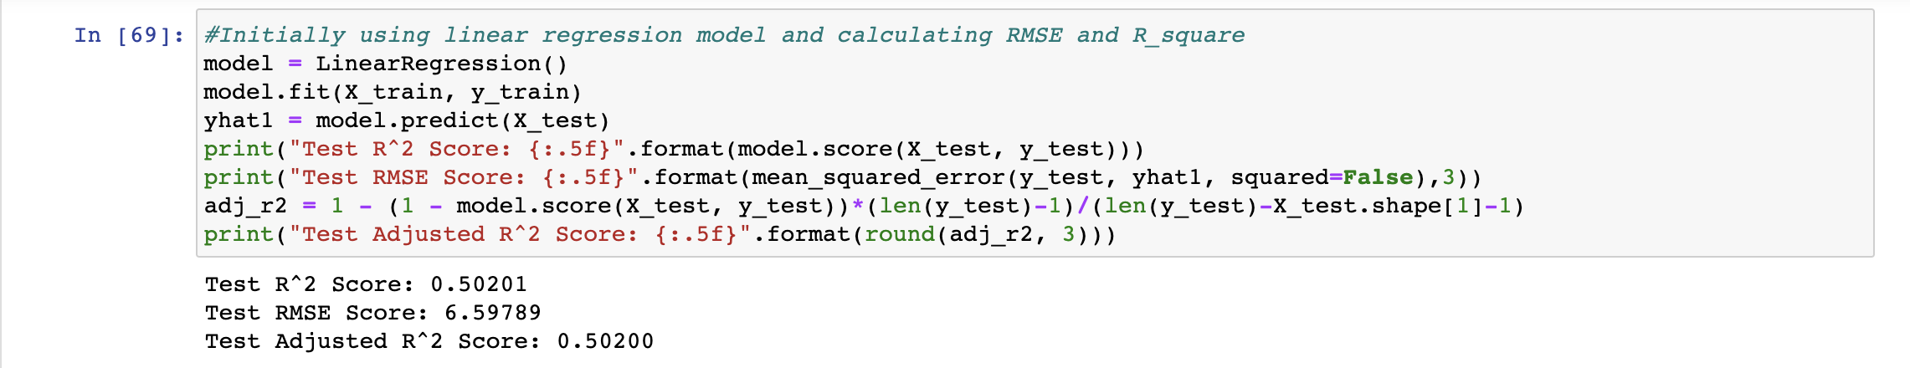
Multiple Regression

Slide 20
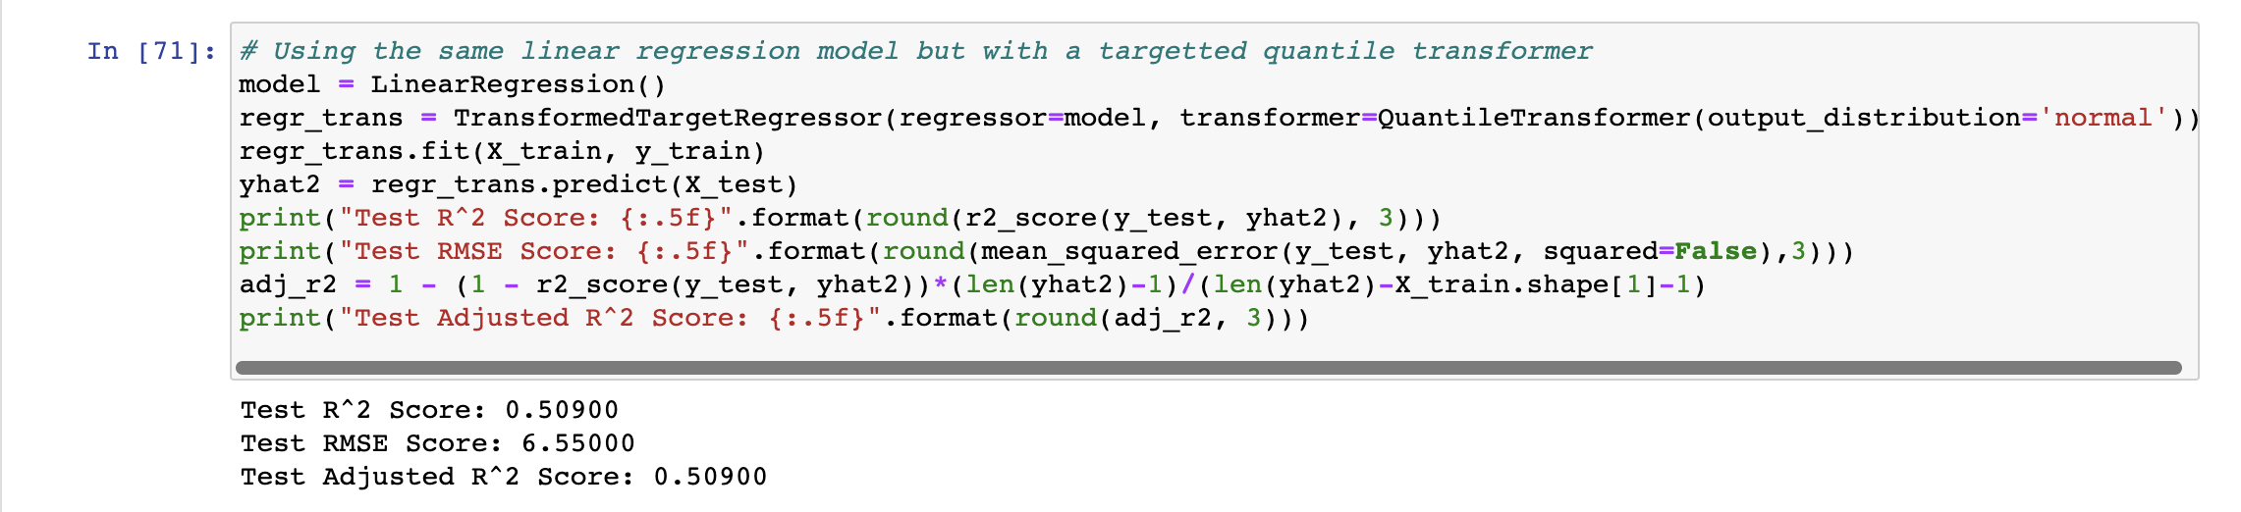
Multiple Regression with Quantile Transformer

Slide 21
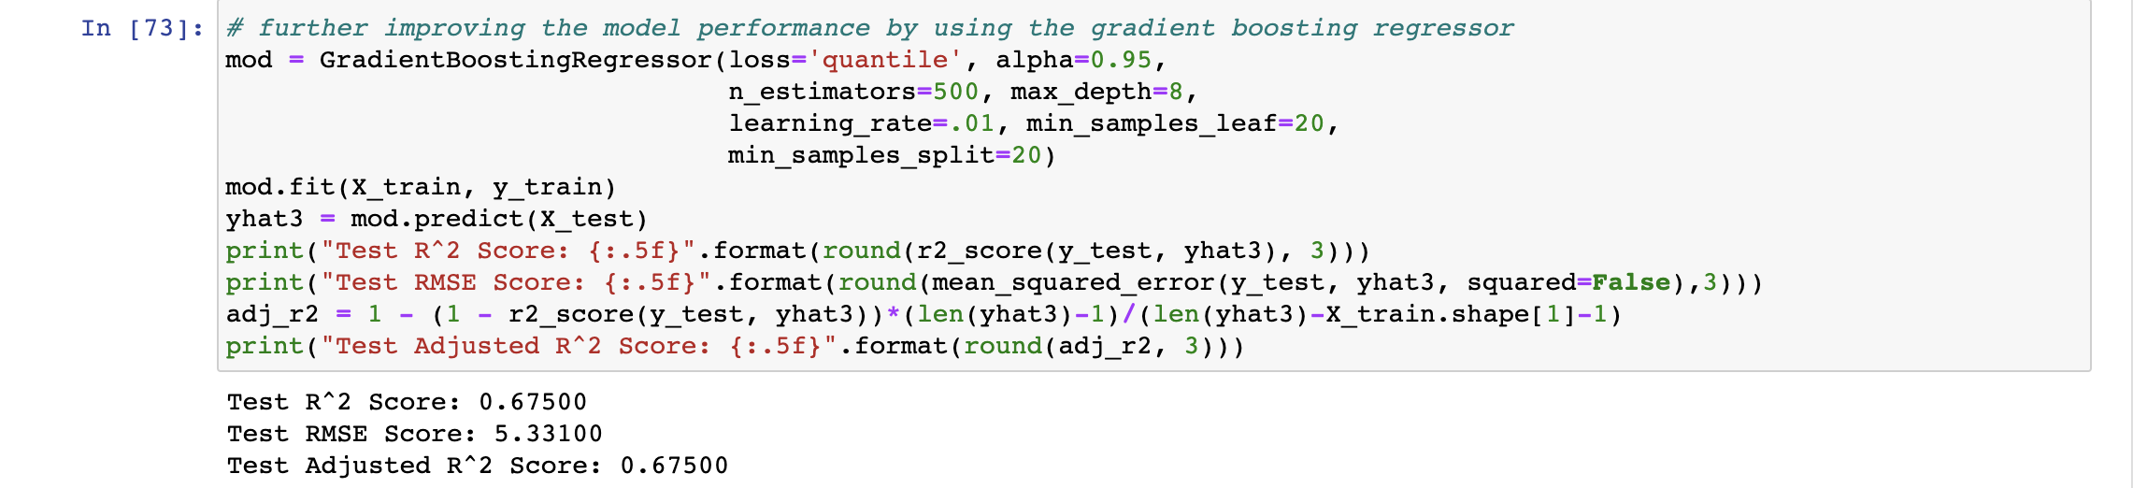
Gradient Boosting Regressor

Slide 22
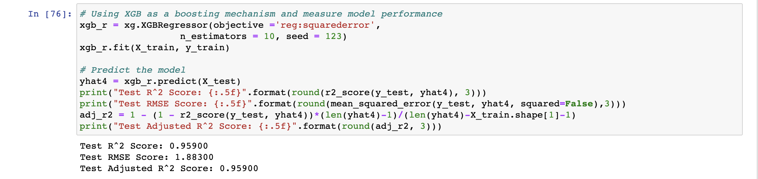
Extreme Gradient Boosting Regressor

Slide 23
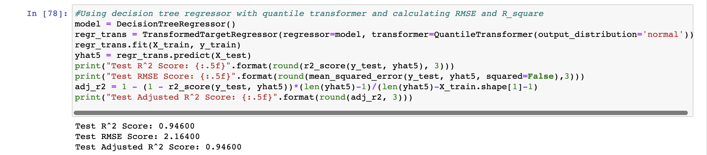
Decision Tree Regressor

Slide 24
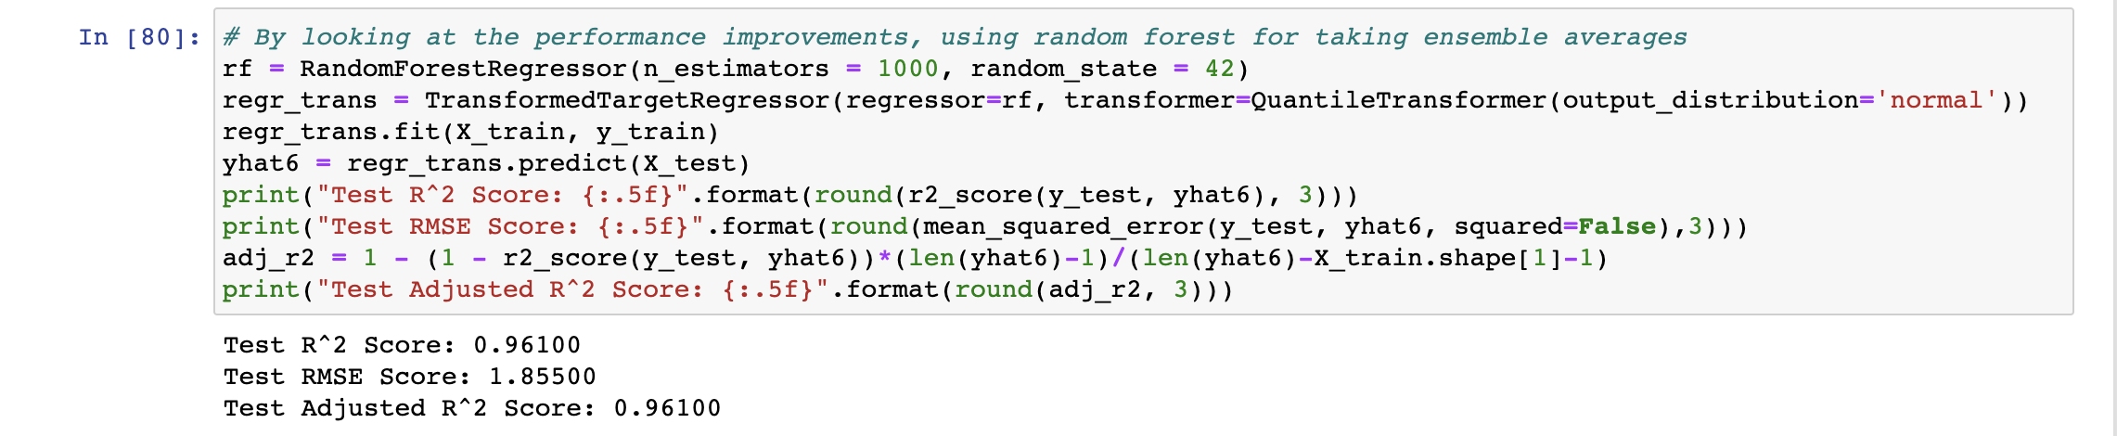
Random Forest Regressor

Slide 25
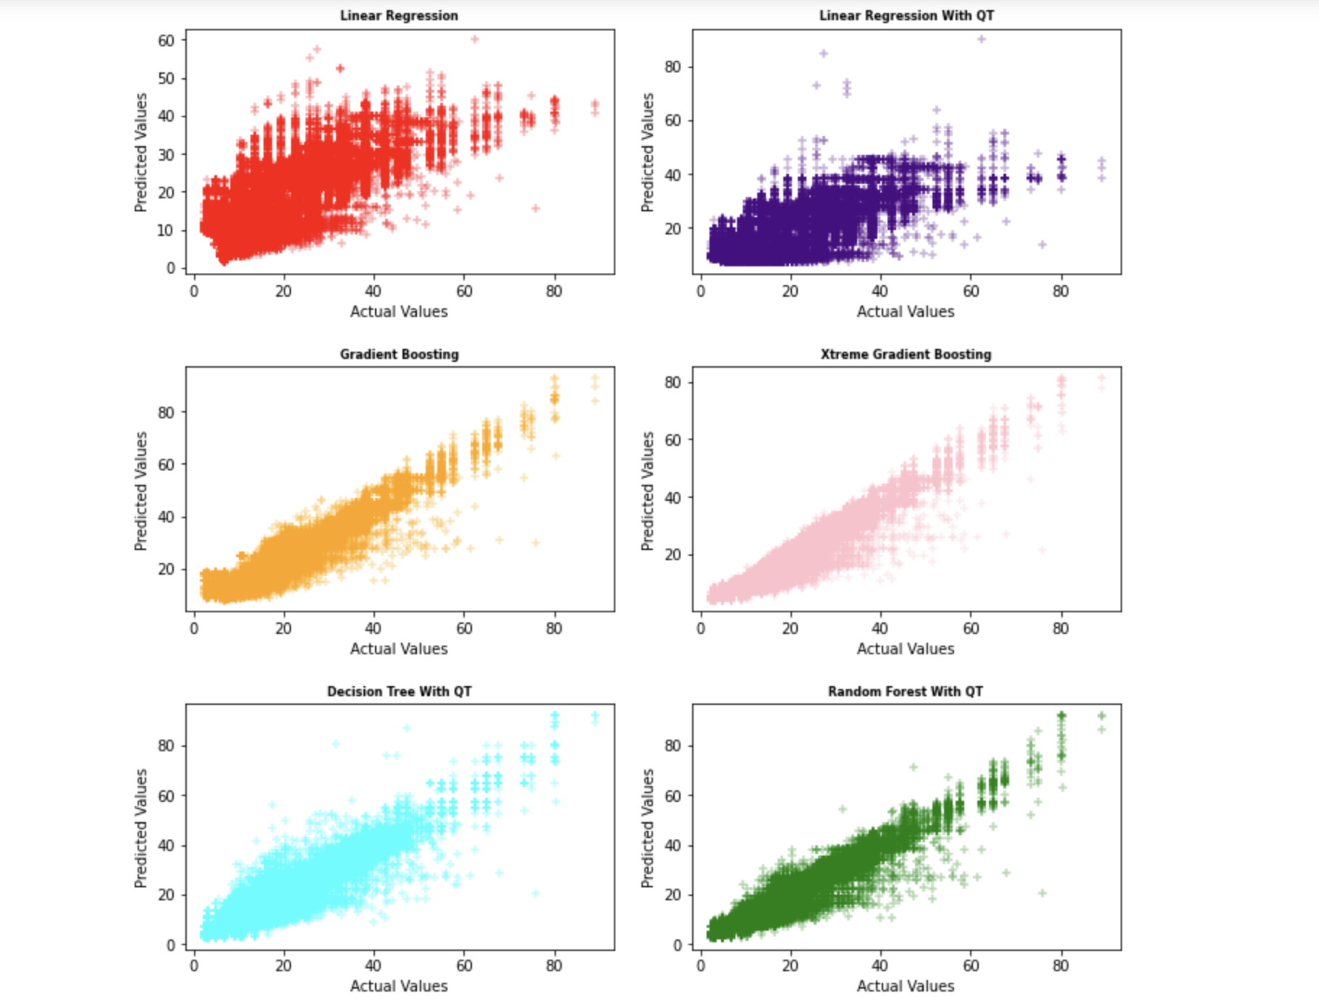
Performance
Comparisons

Slide 26
Thank You

